Slide 1
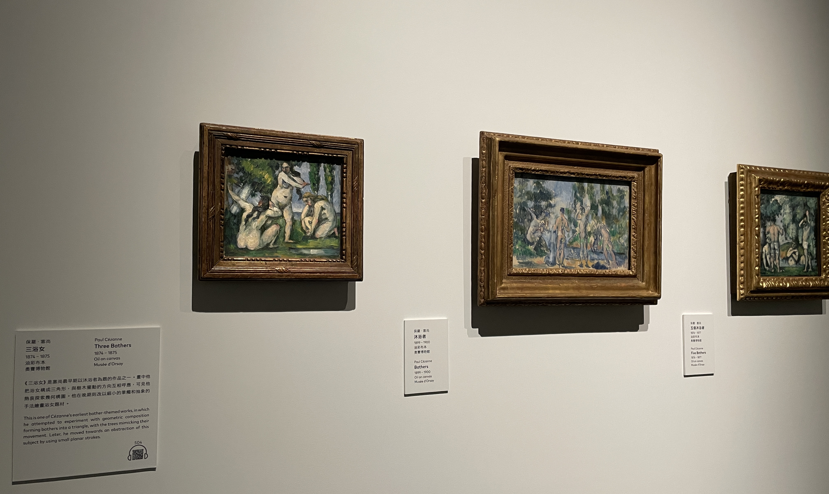
Notes:
Demonstrating the scenario
Feeling lost in exhibition, dun know what to see, want some guidance
The description on the pdf is too wordy

Slide 2
Extended Reality Artefy
Group 4
Alexia Tsang, William Man, William Wat

Slide 3
Table of contents
01
02
03
04
Emphasize
Ideate
Conducting survey with users
Constructing POV and idea brainstorming
Prototype
Feedback
Features in MuseAR
Reflection

Slide 4
01
Emphasize
Knowing more about users and Identify a scenario

Slide 5

Art Museum Visitor
Key Users: tourists or local residents
Interest: Exploring historical artifacts and cultural narratives via Augmented Reality
On Average: 17500 museum visitors per day worldwide
Location: Worldwide Museums

Slide 6
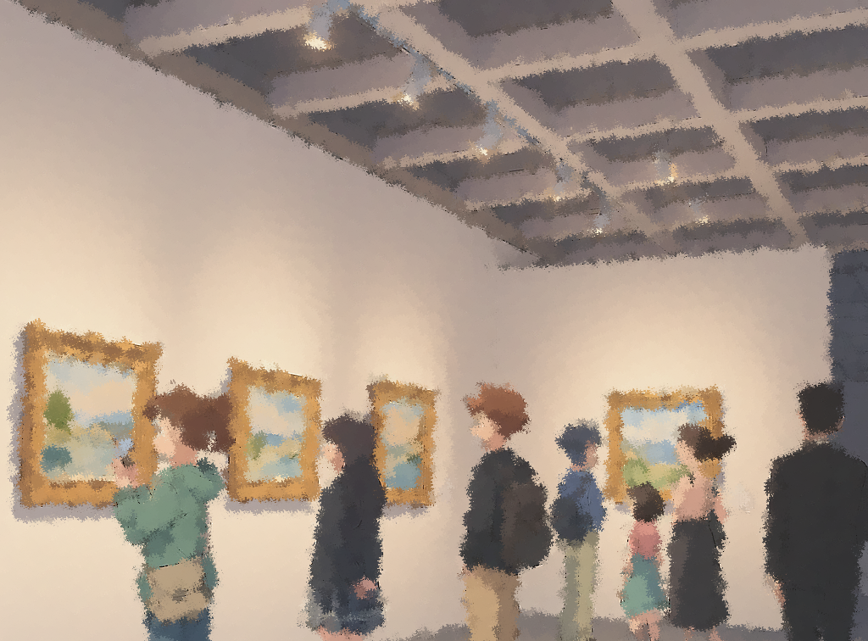
How to know Art Museum Visitors' needs?
Questionnaire: Conduct a survey to understand user experience on visiting art exhibition
Site visit: shadowing and observe the museum visitors

Slide 7
Survey Findings
Existing museum-guides or material hard to access and not interesting
Existing material: not sufficient context or explanation but text-heavy
They prefer learning hidden stories and hearing from artists perspective if they could interact with the artwork

Slide 8
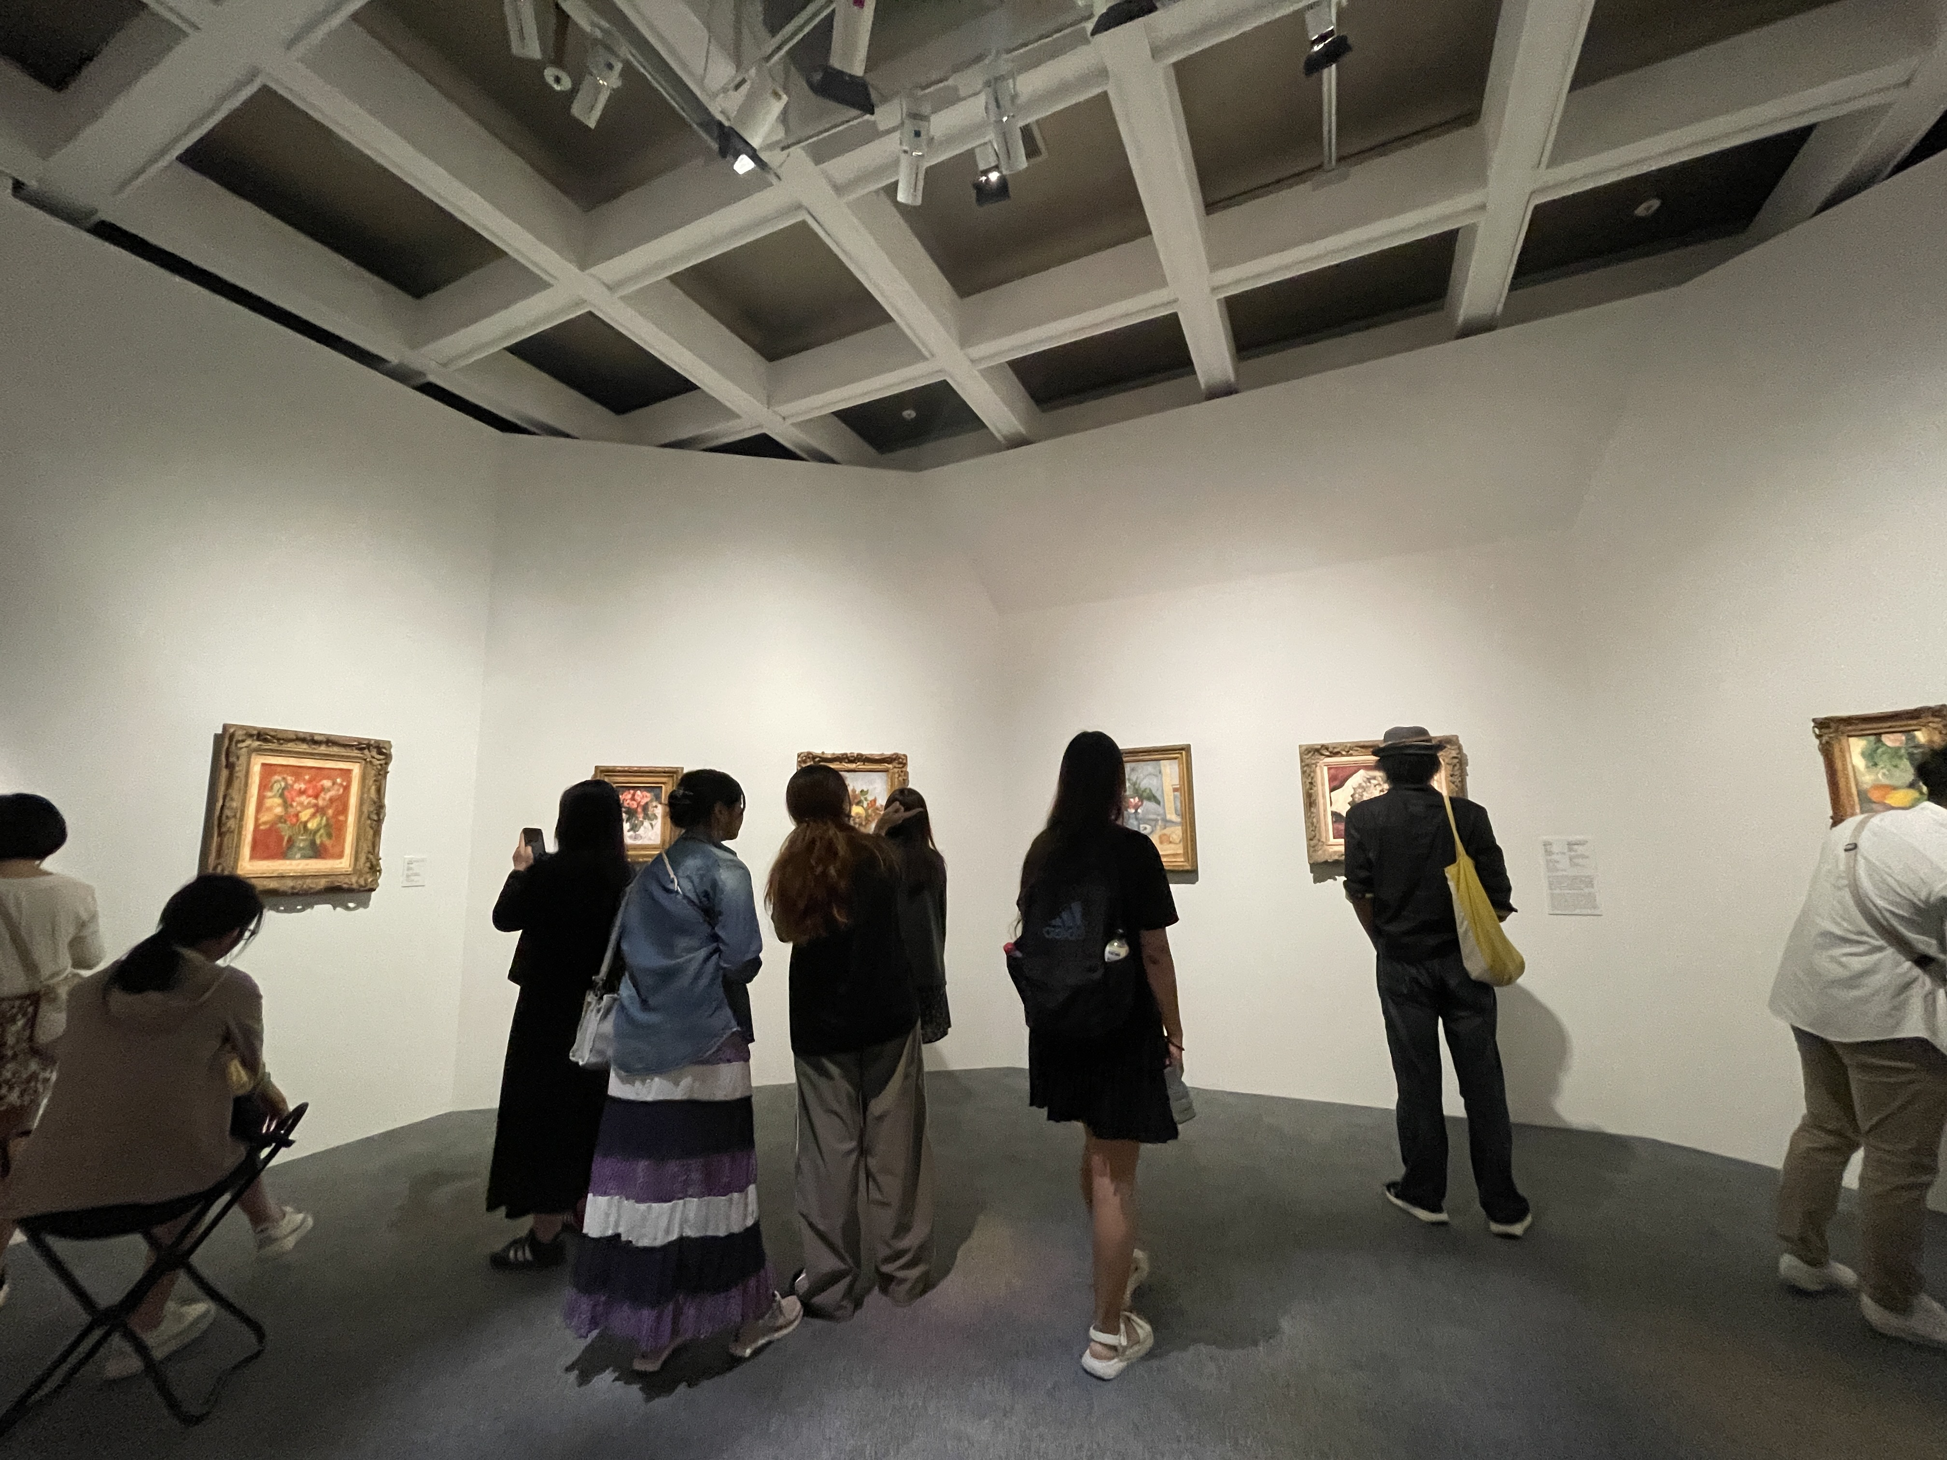
Site Visit
Some visitors were googling the background information about the paintings
They would discuss artists’ life story
They were used to taking photos with their smartphones
Conclusion: perhaps users want to know more than the current museum material provided

Slide 9
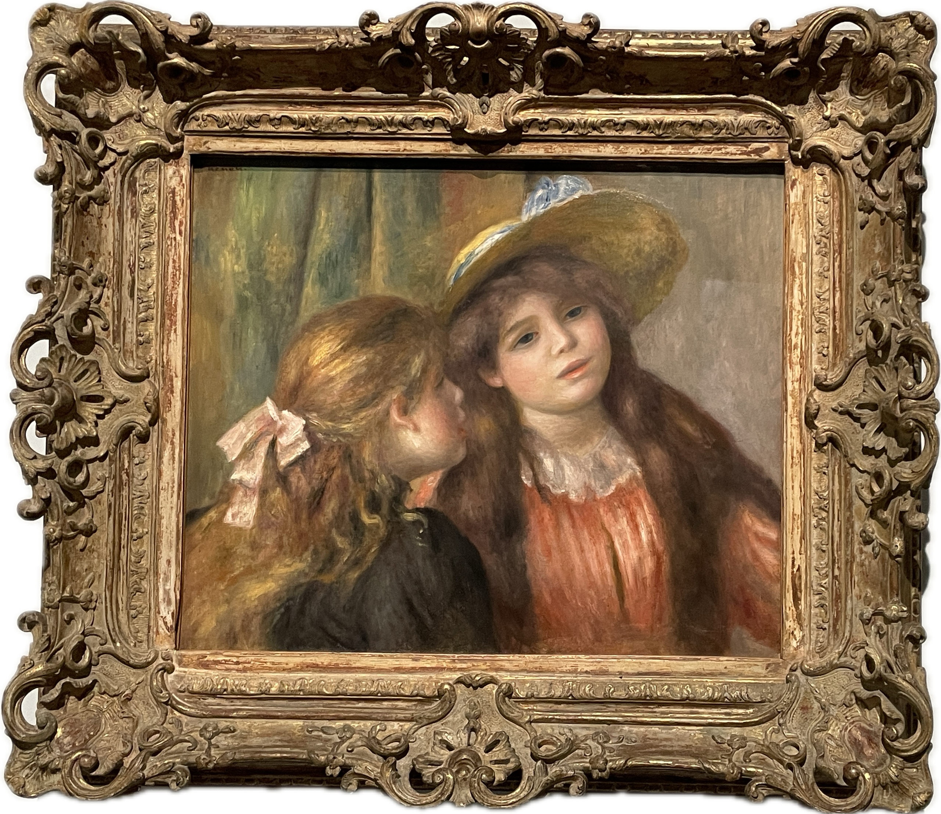
Why Choose Art Museum Visitors?
Unmet need: they want to more interactive guidance in exploring story behind the artwork
Easy access of material
We believe that AR may offer a solution to them as they are comfortable learning more about the artwork with camera

Slide 10
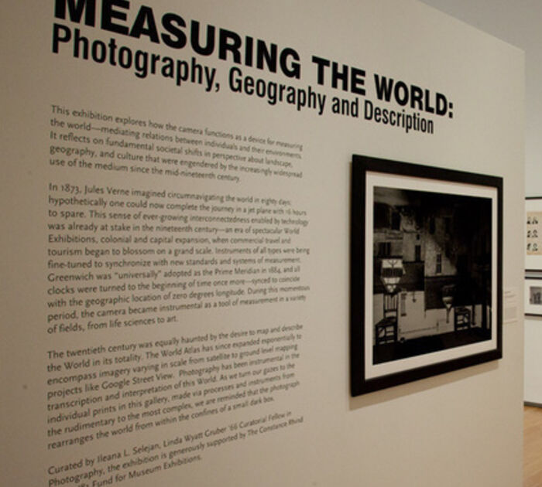
A Scenario
Persona:
Maya, 28, history enthusiast, tour guide
Finds museum text descriptions long and unengaging
Scenario:
Find it hard to read and retain information quickly
Leaves overwhelmed, missing key historical context
Outcome:
Needs a solution to make learning interactive and social

Slide 11
02
Ideate
Construct POV, Brainstorming Idea & Storyboarding

Slide 12
POV: user needs & insights
Museum visitors need simplified and interactive alternatives to enhance their understanding of artwork
Museum visitors want immersive experience to deepen their cultural exploration
Museum visitor need accessible tools to navigate and appreciate the museum efficiently

Slide 13
Brainstorming Idea

Slide 14
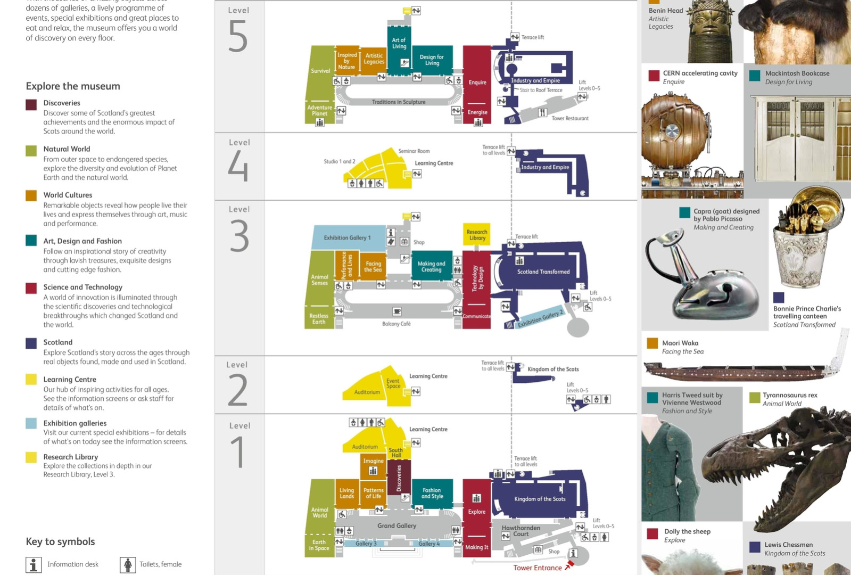
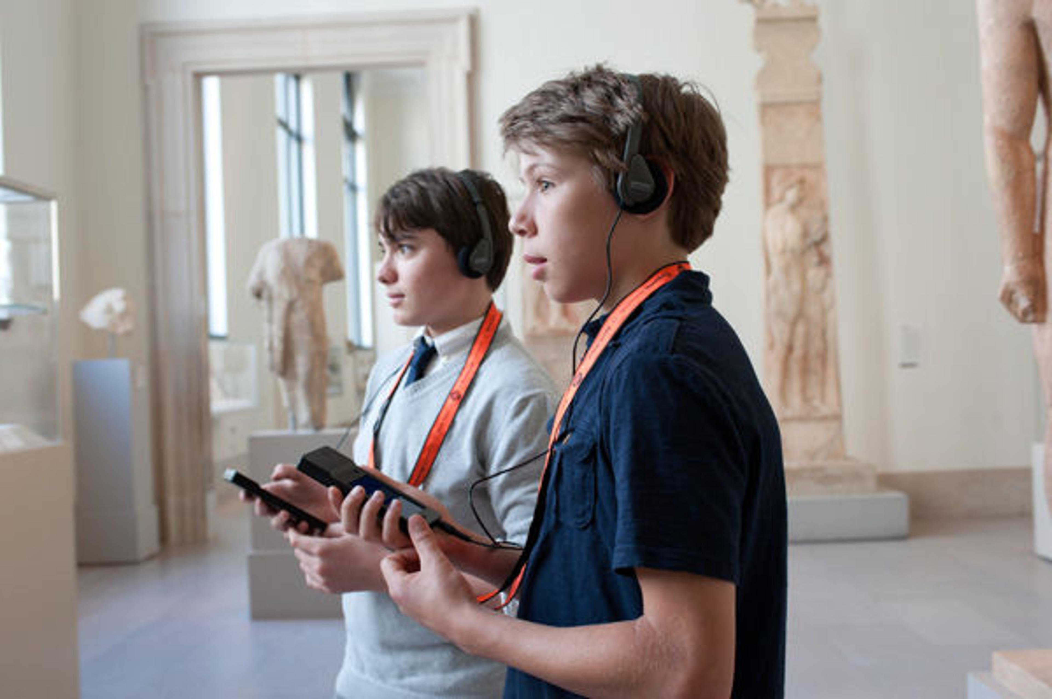

Current Solution
PDF Guides
Audio Guides
Online Search

Slide 15
Current Solution
Current Solutions | Pros | Cons
PDF Guides | Provide detailed written information about exhibits | Often text-heavy and overwhelming for users seeking quick insights Lack interactivity, failing to engage visitors effectively
Audio Guides | Accessible via portable devices Offer multilingual options | Limited to linear audio, missing visual or interactive elements May not cater to diverse learning preferences
Online Search | Allows visitors to search for additional artwork details based on their interests | Information can be scattered or unreliable Disrupting the museum experience

Slide 16
Initial Proposal
What: Implement one or two AR games for the artwork
Why: To enhance interactivity
How: User can access the AR games via the QR code next to the artwork

Slide 17
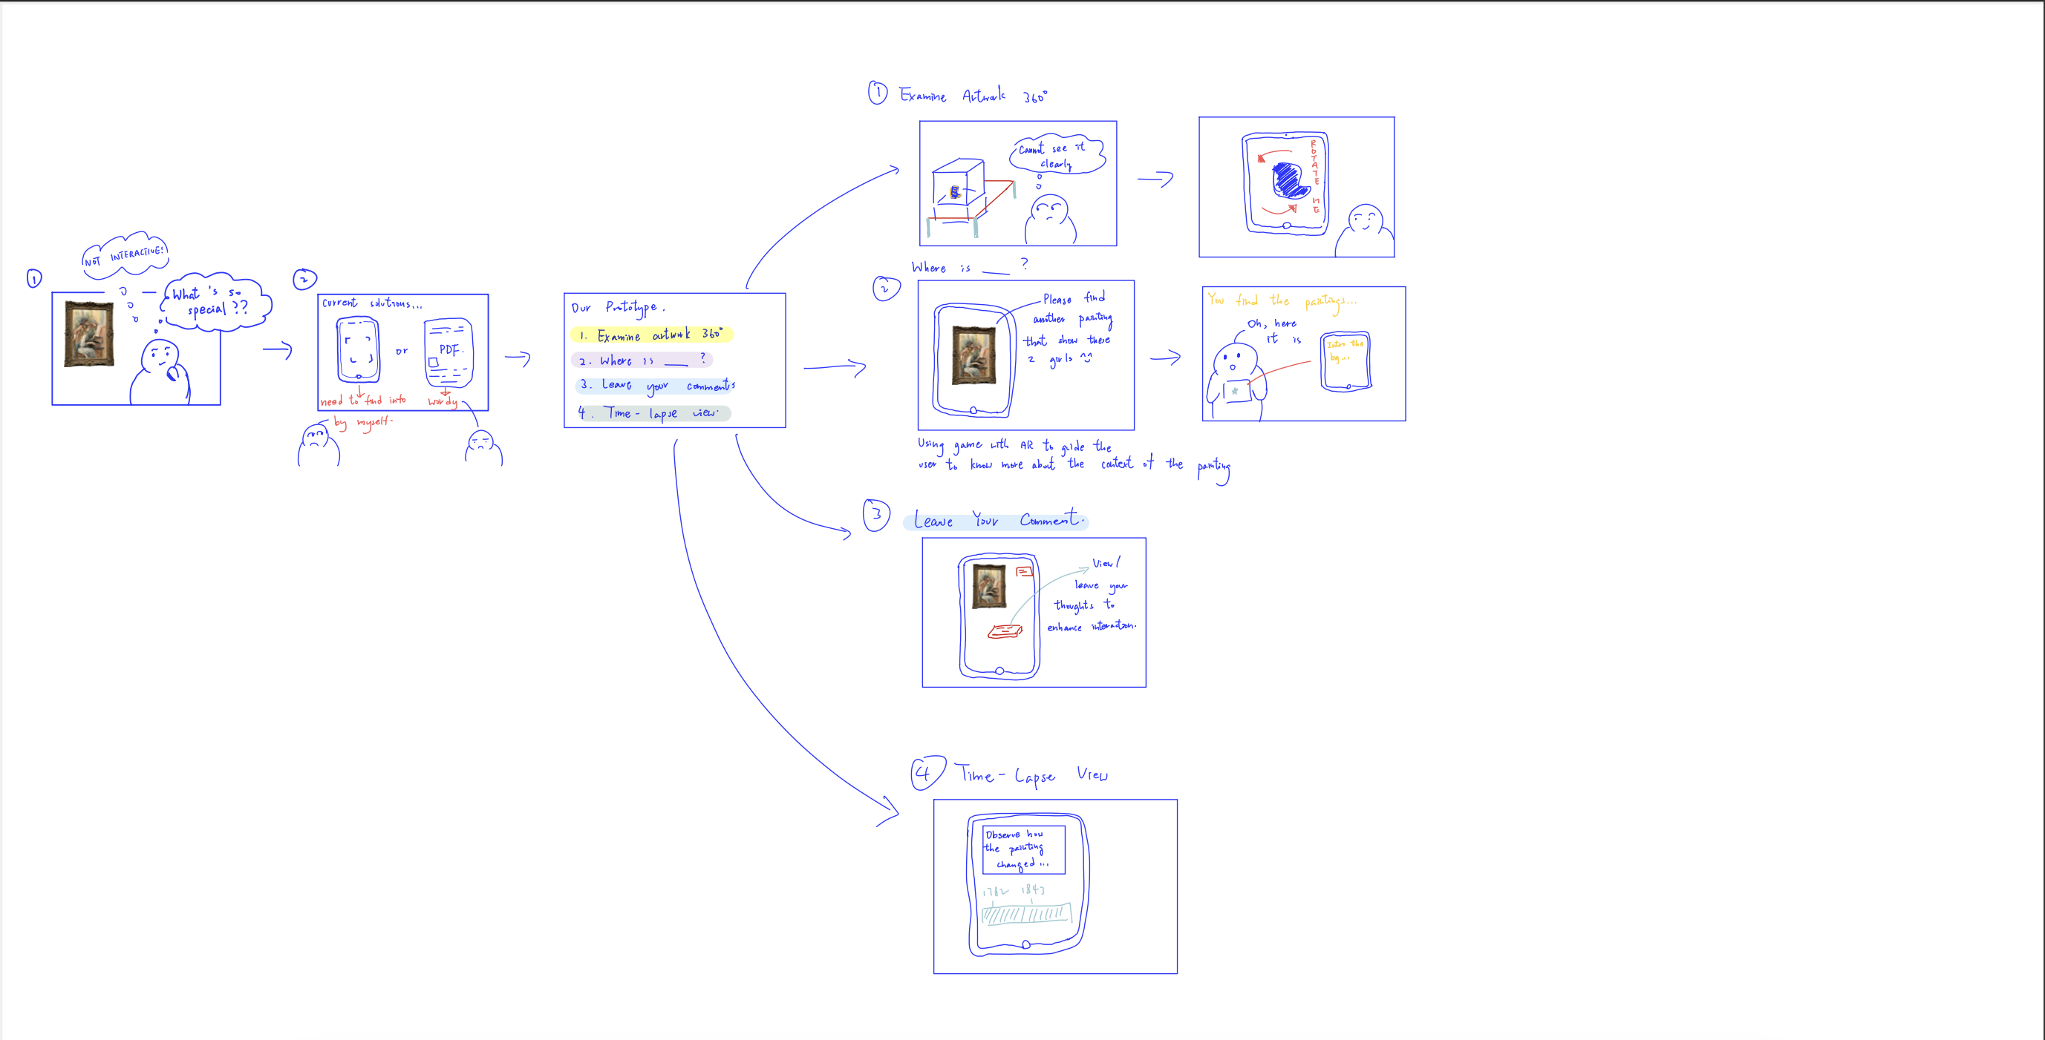
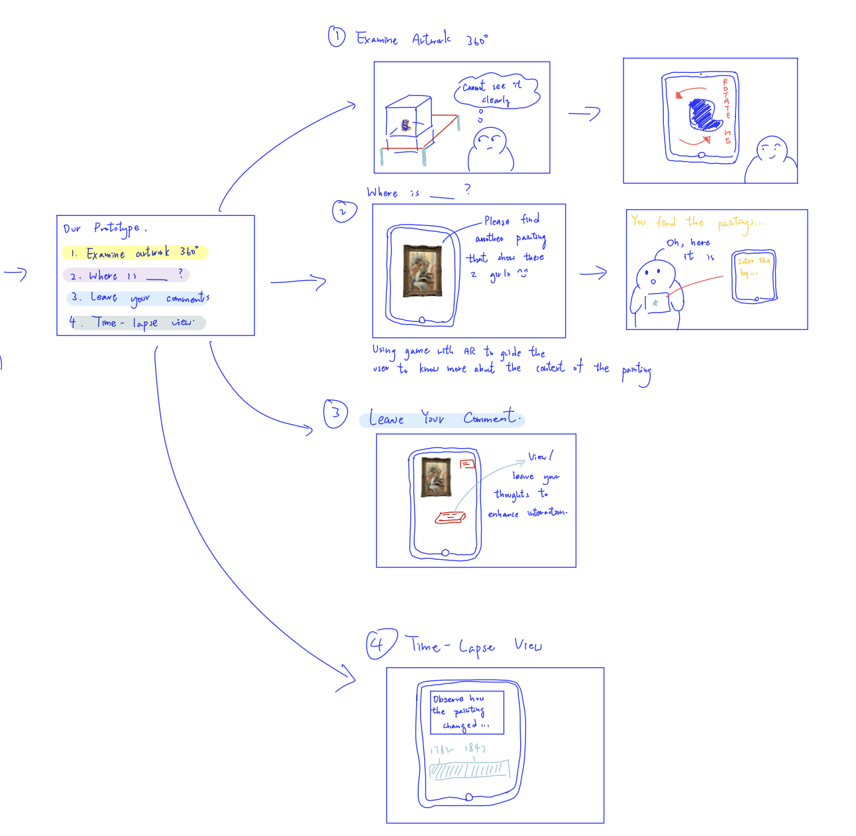
Storyboarding
A user scenario we would like to tackle
Ask user to choose 2 out of 4 proposed features

Slide 18
Storyboarding Result
Our initial propose is to implement 2 out of 4 features
Most users choose "Time-Lapse" feature and "Where is_____" interactive game
"Time-Lapse"
Cool and visually appealing to see how the artwork evolved
Love storytelling feature
"Where is____":
Guide me to explore the artwork by finding specific elements

Slide 19
Recap: What we learn from our users?
Users want various storytelling form in the prototype no limited to AR game only
Expect to learn more about the context and hidden story of both the artwork and artist via the museum provided materials
In the survey response, users don't notice any material available or find them hard to access

Slide 20
Final Design
An all-in-one mobile application that group all the museum material and gamify museum visiting experience
Diversify ways of storytelling to improve user visiting experience, such as virtual artist avatar, time lapse view, spotting details game
Storytelling content: context and hidden story of the artwork and artist

Slide 21
03
Prototype
Building Prototype based on storyboarding results

Slide 22
Four Main Features
Art Around
Viewer Voice
Art Aging
Masterpiece Mystery

Slide 23
Video Demo

Slide 24
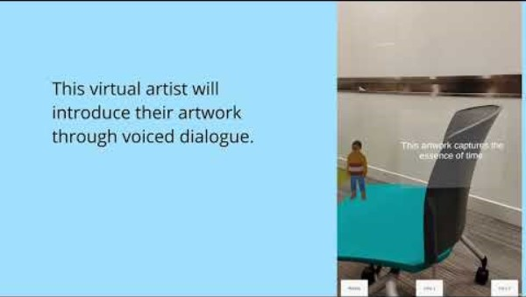

Notes:
https://youtu.be/esC81g8ZoVY

Slide 25
04
Feedback
Conducting Qualitative Analysis

Slide 26
Qualitative user evaluation
How helpful was the voice assistant in providing information about the artworks compared to PDF brochure?
How did you feel about leaving comments on the artworks?
Did reading other users’ comments enhance your experience or influence your perspective on the artwork?
What was your experience with the time-lapse view of the artwork? Did it add value to your visit?

Slide 27
User Feedback
Masterpiece Mystery: showing fun fact via virtual avatar and finding game
Engaging for users as less wordy
Can meet their needs of knowing more about hidden story
Improvement: More clearer instruction
Art Around: 360-Degree Artifact Rotation
Zoom and rotation is hard to control
Improvement: can provide tutorial and visual element like arrow to
user to learn

Slide 28
User Feedback
Viewer Voice: Interactive Comment Board
Concern that comments may clutter if many users’ comment
More interactive as I can share my thought with others
Improvement: would be great if user can reply other comment
Art Aging: Artifact Time-Lapse View
“Fun” and “Must have”
Make the creative process feel more alive
Improvement: can pause and zoom in or can co-create with the artists

Slide 29
Overall Experience
Fosters curiosity and inspiration
Enhances engagement by offering immersive and interactive ways to explore artworks
No overwhelming or disconnected moments
May lack competitive advantages
Lack unique features compared to existing AR apps

Slide 30
Improvement
More clearer instruction in UI to enhance zoom functionality
Implement comment moderation or filtering to prevent clutter from excessive comments
Introduce a feature for direct interaction with artists using AI
Stronger linkage between each mission

Slide 31
Our Lesson Learnt
When designing the prototype, we would consider more on user habit and offer more clearer instructions in the UI
There are many ways to express the idea of art beyond just using text.
For the average visitor, a simple and accessible way to understand art is often preferred.

Slide 32
Thanks!
Do you have any questions?

Slide 33
Reference
https://clipart-library.com/clipart/beret-cliparts_13.htm
https://www.figma.com/community/file/1043459494713403436/ar-museum-guide
https://www.figma.com/design/Mt87DydBCjVcU3g1dDwnHy/IOS-Native-Video-Player--Community-?node-id=4-2389&t=25RxyuMPRTA3BoPl-0
https://www.figma.com/design/PXS6SFG1CEKcsPXA11AcFV/Apple-Vision-Pro-home-screen--Community-?node-id=128-2327&t=RfNRLeqhwfNHHPlL-0
https://ttsmaker.com/

